Slide 1

DAILYSPEND: DAILY EXPENSE TRACKING & BUDGET MANAGEMENT SYSTEM USING REACT
CS23531 - Web Programming
Department of CSE
Name : Mohammed Rizwan Sheik Mansoor
Register Number : 240701327
Domain : Web Development (Frontend Development)

Slide 2
Abstract
DailySpend is a web-based application designed to facilitate systematic personal financial management through the recording, monitoring, and analysis of daily income, expenditures, and monthly budgets.
The application provides an integrated and user-friendly interface that enables users to maintain transaction records, categorize expenses, establish budget limits, and review financial summaries. The system is developed using HTML, CSS, JavaScript, and React, while browser Local Storage is employed for persistent data storage.
The primary objective of DailySpend is to enhance the efficiency of personal expense management, promote informed financial decision-making, and encourage responsible spending habits through an accessible and organized digital platform.

Slide 3
System requirements
Hardware Requirements
Processor: Intel Core i3 or equivalent and above.
RAM: Minimum 4 GB; 8 GB recommended.
Storage: Minimum 1 GB of free disk space.
Internet Connection: Required for accessing the deployed application and online resources.

Slide 4
System requirements
Software Requirements
Frontend: HTML5, CSS3, JavaScript.
Frontend Framework: React.js.
Build Tool: Vite.
Data Storage: Browser Local Storage.
Code Editor: Visual Studio Code.
Browser: Google Chrome or Microsoft Edge.
Operating System: Windows, Linux, or macOS.
Deployment Platform: Vercel.
Version Control: Git and GitHub.

Slide 5
MODULES IMPLEMENTED
Login and Sign-Up Module: Enables users to register and access the application through a basic authentication interface.
Dashboard Module: Displays total income, total expenses, current balance, and recent transactions.
Transaction Management Module: Allows users to add, edit, and delete income and expense records.
Transaction History Module: Provides transaction search, filtering, sorting, and historical record viewing.
Budget Management Module: Enables users to set monthly and category-wise budgets and monitor spending.
Reports and Financial Summary Module: Presents numerical summaries of income, expenses, and category-wise expenditure.
Profile and Settings Module: Provides account-related settings, logout, and data management options.

Slide 6
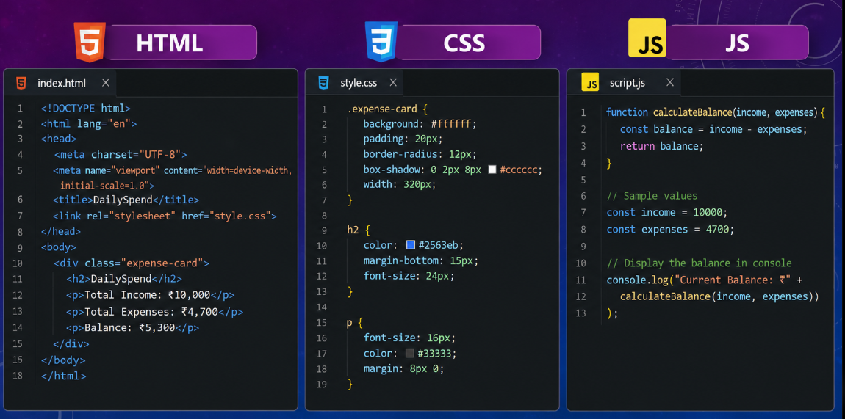
SAMPLE CODING

Slide 7
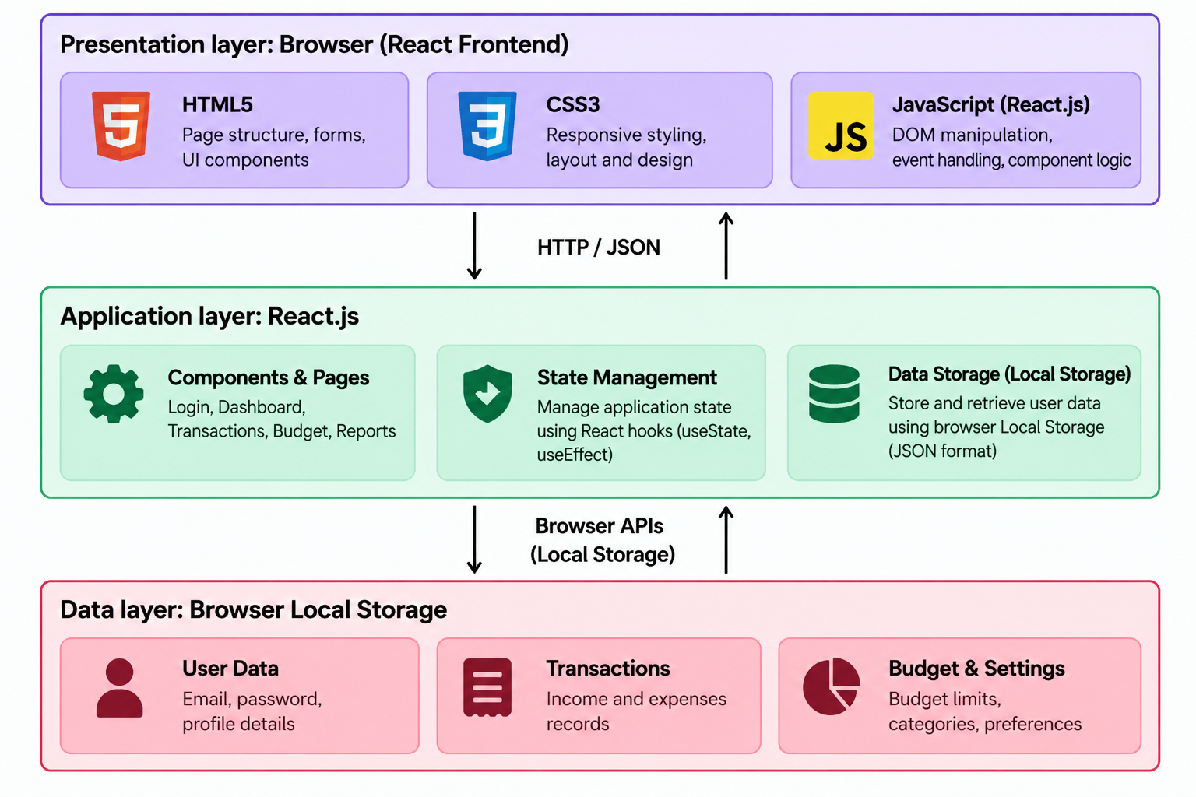
ARCHITECTURE DIAGRAM

Slide 8
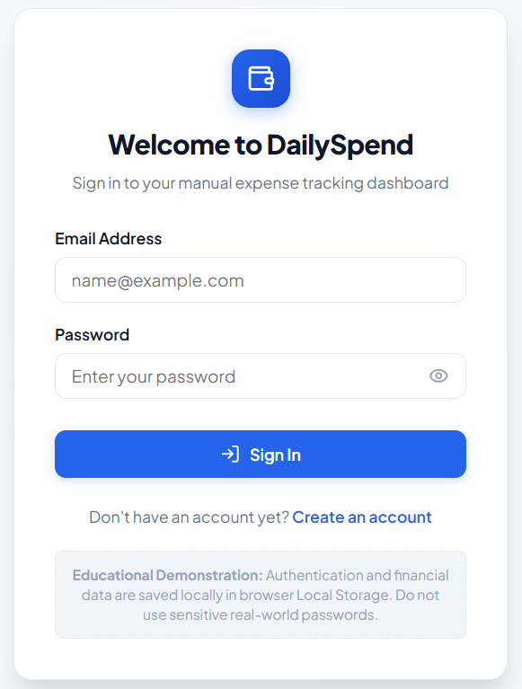
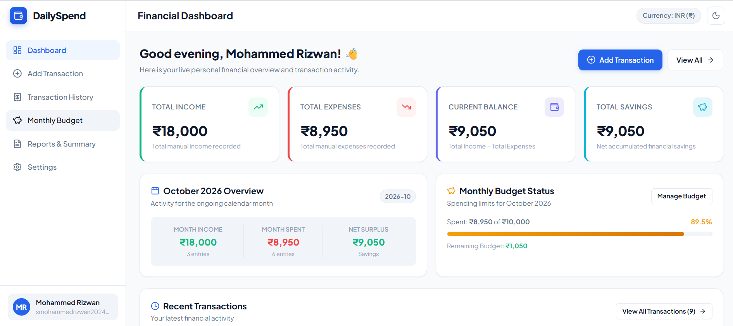
DEMO Of THE PROJECT

Slide 9
CONCLUSION
DailySpend provides a simple and convenient platform for managing personal finances through systematic tracking of income, expenses, and monthly budgets. By integrating HTML, CSS, JavaScript, and React, the application offers an interactive and user-friendly interface, while browser Local Storage enables the persistence of financial records without requiring a backend server or cloud database.
The application helps users organize transactions, monitor spending patterns, maintain budget limits, and review financial summaries. It can be further enhanced by integrating cloud-based data storage, secure authentication, data export, advanced financial analytics, and automated budget notifications.
Overall, the project demonstrates the practical application of frontend web development in building an accessible and efficient solution for personal expense tracking and budget management.

Slide 10
Project Links
GitHub Repository:
https://github.com/mohammedrizwancse/240701327-CS23531-WebProgramming-Lab
Live Deployment:
https://dailyspend-ivory.vercel.app

Slide 11
THANK YOU

